Slide 1
Match 2017!!!

Slide 2
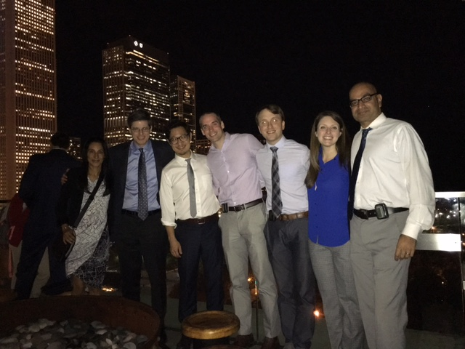
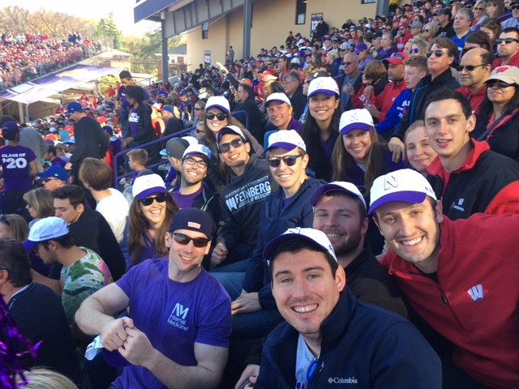
Special Thanks
Douglas Vaughan
2016-17 Chief Residents
Meredith Sellers
William Werbel
Alex Lemmer
Greg Cascino

Slide 3
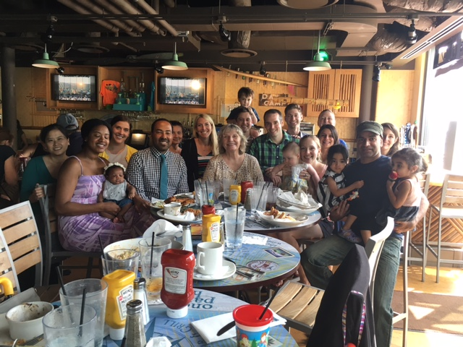
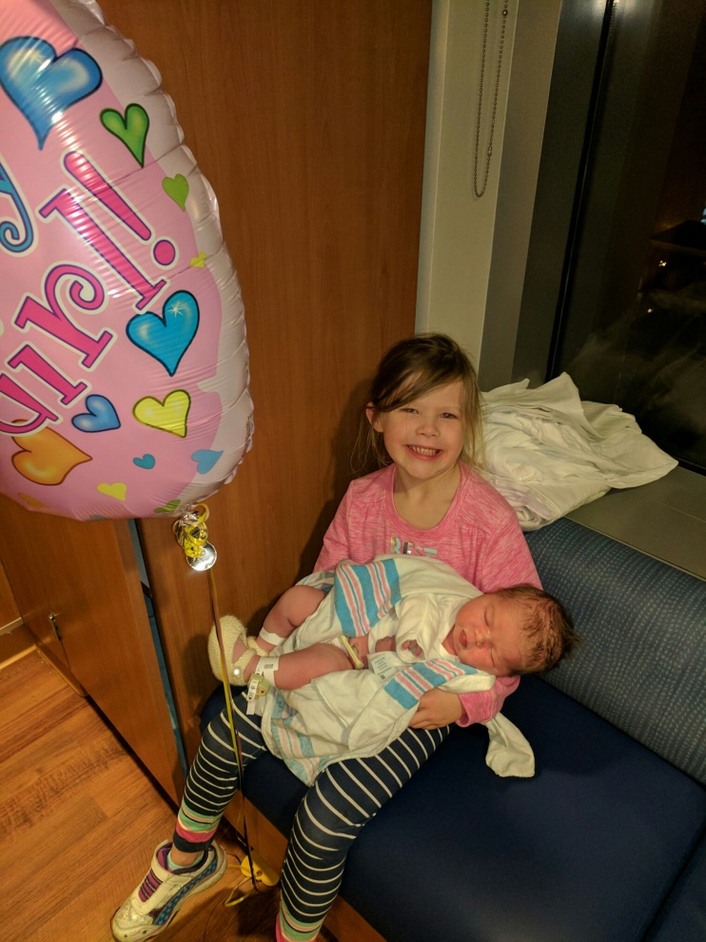
Special Thanks
Warren Wallace
Aarati Didwania
Dave Neely
Kim Dow
Sara Kiely
Anna-Kate
Socorro Esparza
Judy Poremba
Rana Khalifeh

Slide 4
Special Thanks Selection Committee
Mike Angarone
Jeff Barsuk
Mobola Campbell-Yesufu
Greg Cascino
Vinky Chadha
Margaret Chapman
Yusra Cheema
Rachel Cyrus
Aarati Didwania
Dan Evans
Jim Foody
Rob Hirschtick
Sadiya Khan
Cheryl Lee
Alex Lemmer
Gary Martin
Dave Neely
Sean O’Connor
Jim Otto
Jay Paparello
John Pandolfino
Meredith Sellers
Ben Singer
Pat Tosetti
Dave Vermylen
Julie Vermylen
Diane Wayne
Warren Wallace
William Werbel

Slide 5
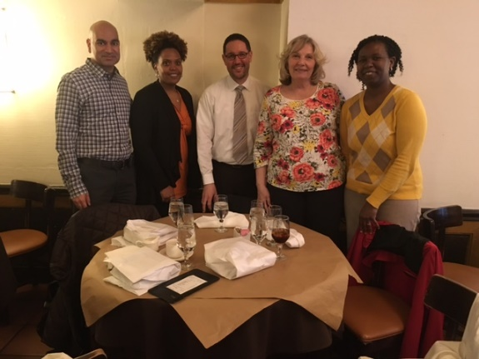
Special Thanks
Mobola Campbell-Yesufu, Khalilah Gates and Natasha Nichols
Diversity and Cultural Affairs Council
Brigid Dolan
Women’s Health and Professional Development
Ben Singer
Physician Scientist Training Program

Slide 6
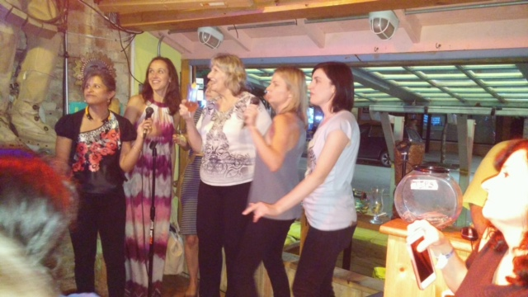
Distinguished Interviewers
All-star
Pat Tosetti – 19!
Bled Purple
Alex Lemmer
Outdid himself
Jim Foody - 8
Tom Holly – 12
Cheryl Lee – 12
Emily Jones – 11
HG Munshi – 11
Cesar Santa-Maria – 11
Dave Neely – 10
Rob Hirschtick – 10
Sheridan Meyers – 10
Frank Giles – 10
Pete Flevaris – 10
Arv Vanagunas – 9
Clara Schroedl – 9
John Flaherty – 9
Margaret Chapman – 9
Michael Angarone – 9
Cal Brown – 9
Bill Gradishar – 9

Slide 7
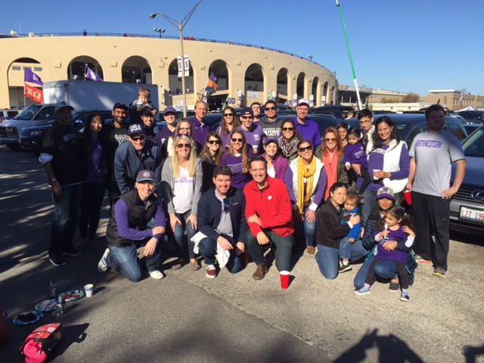
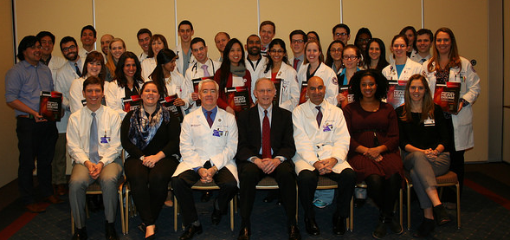
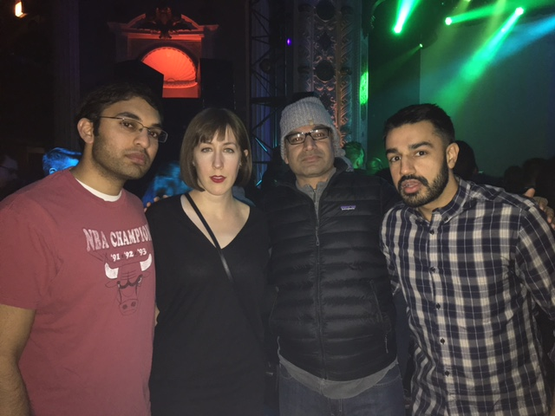
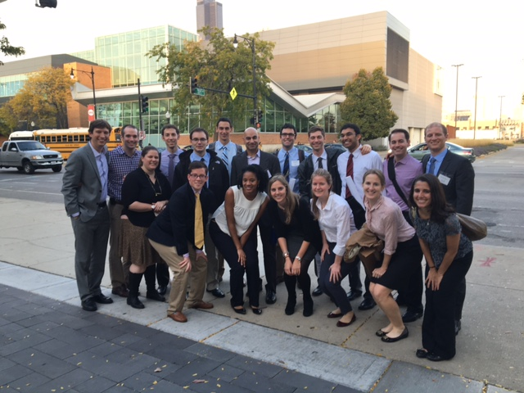
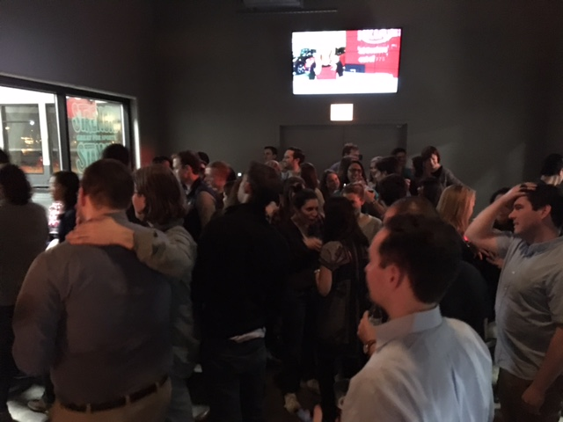
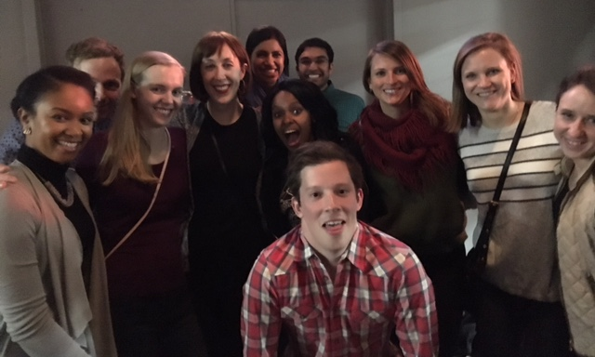
Props to the Residents

Slide 8
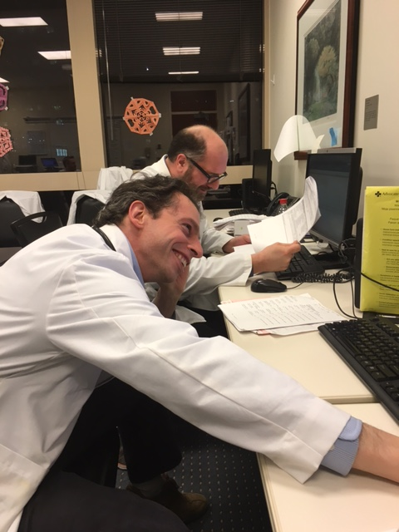
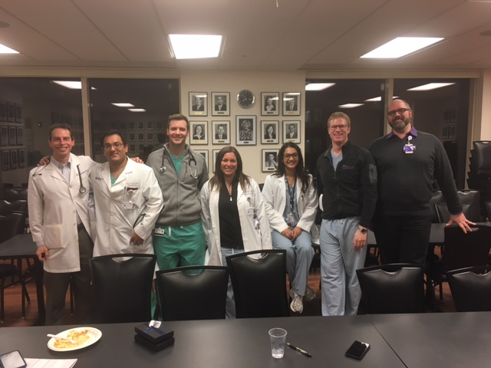
Whirlyball “Bowling Night” Crew
Erica Donnan
Joe Triggs
Ali Frogameni
Lakshmi Sivarajan
Arif Jivan
Lowie Van Assche
Suneel Kamath
Mariel Rosati
Kari Krueger
Dr. Angarone
Dr. Boyd
Dr. Cheema
Dr. Paparello
Dr. Rupal Mehta

Slide 9
Match 2017!!! Stats and Results

Slide 10
The Applicant Pool
3172 Categorical applications
1992 US medical school graduates
424 AOA
601 Top 25 Med School
→400 Interviewed
1082 Prelim applications
332 PSTP applications
100 Med Derm applications

Slide 11
Summary
34 Categorical, 4 PSTP, 2 Prelims, 1 MedDerm
61% Female & 39% Male
40% AOA
63% from top 25 schools
12% from underrepresented minority groups

Slide 12
Preston Atteberry
Medical School:
Mount Sinai
Undergraduate:
University of Chicago
Interviewed By:
Dr. Martin & Dr. Hanauer
Interesting fact:
U of C Baseball Player
Econ degree (worked with Nobel Laureate)
Project on healthcare for the low-income families
Born in Fort Worth, TX

Slide 13
Jayson Baman
Medical School:
University of Rochester
Undergraduate:
University of Rochester
Interviewed By:
Dr. Montalvo & Dr. Puthumana
Interesting fact:
Medical Editing elective for JAMA
Budding cardiologist with great research
Born in Kalamazoo, MI

Slide 14
Megan Barrett-Englert
Medical School:
University of Kentucky
Undergraduate:
Northwestern
Interviewed By:
Dr. Moore & Dr. Emily Martin Jones
Interesting fact:
A part of singing group called “Medtones”
Gold Humanism
Multiple research projects in GI
Born in Chicago, IL

Slide 15
Aakash Bavishi
Medical School:
Northwestern
Undergraduate:
Northwestern
Interviewed By:
Dr. Barsuk & Dr. Perlman
Interesting fact:
Research on role of diurnal variation and circadian rhythms on eczema
Avid Chicago sports fan – NBA & NFL
Born in Elk Grove Village, IL

Slide 16
John Bowers
Medical School:
Vanderbilt
Undergraduate:
University of Florida
Interviewed By:
Dr. Lewis Smith & Dr. Sellers
Interesting fact:
Piano player
Research in Heart Failure Biomarkers
Project on Abx and Esophagitis
Born in Durham, NC

Slide 17
Charlotte Campbell
Medical School:
University of Virginia
Undergraduate:
University of Virginia
Interviewed By:
Dr. Ditto & Dr. Henschen
Interesting fact:
Marathon runner
Gold Humanism
Project on adherence in Crohn
Born in Richmond, VA

Slide 18
Patrick Campbell
Medical School:
University of North Carolina
Undergraduate:
North Carolina State
Interviewed By:
Dr. Costas & Dr. Brenner
Interesting fact:
NCSU’s Male Scholar Athlete of the Year – 2013 (Track & Cross Country)
IBD research
Born in Charlotte, NC

Slide 19
Michael Chen - PSTP
Medical School:
Loyola
Undergraduate:
University of Wisconsin
Interviewed By:
Dr. Perlman, Dr. Brown, Dr. Schleimer, Dr. Marangoni
Interesting fact:
Interest in Allergy
PhD on how gut involved in lung inflammation.
“Best researcher at Loyola” - Fenton
Born in Sewell, NJ

Slide 20
Kasey Coyne
Medical School:
Northwestern
Undergraduate:
Boston College
Interviewed By:
Dr. Heitor & Dr. Santa-Maria
Interesting fact:
Co-wrote, directed, and produced In Vivo
Worked 5 years as a research asst in health policy at Mt. Sinai
Research to develop an app about healthy food choices (Food Switch)
Born in Seoul, Korea

Slide 21
Danielle Cuthbert
Medical School:
Northwestern
Undergraduate:
McGill University
Interviewed By:
Dr. Meyers & Dr. Mehta
Interesting fact:
Worked 2 years as an event planner in Toronto
Global Health work including project on attitudes towards placentophagy…
Heme/Onc interest
Born in Toronto, ON

Slide 22
Celso Diaz
Medical School:
UCSF
Undergraduate:
Notre Dame
Interviewed By:
Dr. Costas & Dr. Meyers
Interesting fact:
Work with undocumented immigrants. Teaches medical spanish.
Interest in cancer with project on Ca 19-9
Born in Los Angeles, CA

Slide 23
Sally Friedman
Medical School:
University of Texas – San Antonio
Undergraduate:
Tulane University
Interviewed By:
Dr. Bierman & Dr. Urdaneta
Interesting fact:
Paul M. Green Scholarship for Excellence in Medical Education (coaching)
Significant Global Health experience (Guatamala)
NBA fan (Spurs >> Bulls)
Born in Houston, TX

Slide 24
Jordan Gavin
Medical School:
Wayne State
Undergraduate:
University of Michigan
Interviewed By:
Dr. Feinstein & Dr. Sutton
Interesting fact:
William J. Branstrom Prize - Received for ranking in the top five percent of the class at UofM
Projects and pubs in AML research and in medical education (OSCE on breaking bad news)
Born in Royal Oak, MI

Slide 25
Jasleen Ghuman
Medical School:
U of Missouri
Undergraduate:
Highland College
Interviewed By:
Dr. Peters & Dr. Campbell-Yesufu
Interesting fact:
NIH, NIDDK Research Award – DM effect on blood brain barrier
PCT for 2 years in Seattle
Born in Chandigarh, India

Slide 26
Peter Glynn
Medical School:
Northwestern
Undergraduate:
Boston University
Interviewed By:
Dr. Russell & Dr. Lee
Interesting fact:
Project doing cognitive rehab in patients with aphasia using an iPad
Couples matched with Alexandra Moise in Neuro
Born in Dover, NH

Slide 27
Sarah Hale
Medical School:
Loyola
Undergraduate:
Notre Dame
Interviewed By:
Dr. Costas & Dr. Pettijohn
Interesting fact:
English major
Worked with autistic children
Research in Lymphoma
Born in Maywood, IL

Slide 28
Jennifer Jo
Medical School:
Emory
Undergraduate:
Northwestern University
Interviewed By:
Dr. Stosor & Dr. Sutton
Interesting fact:
Project on using PrEP in folks at high risk for HIV in county health system.
Spent a year as a lab tech
Born in St. Louis, MO

Slide 29
Parul Kathuria - MedDerm
Medical School:
Northwestern
Undergraduate:
Northwestern
Interviewed by:
Dr. Moore & Dr. Basil
Interesting fact:
Project with Dr. Cuttica on PESI score
Ice Hockey Player – go Hawks!
Born in Southfield, MI

Slide 30
Megan Kosirog
Medical School:
Rush
Undergraduate:
Illinois Wesleyan University
Interviewed By:
Dr. Weaver & Dr. Mendelson
Interesting fact:
Rock climbing and 80s alternative music fan
Project on social networks and health behaviors.
Born in Park Ridge, IL

Slide 31
Kaitlin (Blatt) Lima
Medical School:
University of Cincinnati
Undergraduate:
Indiana University
Interviewed By:
Dr. Saltoun & Dr. Frogameni
Interesting fact:
Research related to smoking cessation in pregnancy
Interest in Global Health – National grant awardee for work in Ecuador
Born in San Antonio, TX

Slide 32
Elyse Linson
Medical School:
Georgetown
Undergraduate:
Emory University
Interviewed By:
Dr. Nichols & Dr. Keswani
Interesting fact:
MPH from Boston University
2015 SPIRIT Award Recipient for exemplifying cura personalis through dedication to patient care and advocacy
Born in Springfield, MA

Slide 33
Elisa McEachern
Medical School:
Cornell
Undergraduate:
University of California – San Diego
Interviewed By:
Dr. Mahieu & Dr. Werbel
Interesting fact:
Spent 2 years doing bench research in Cali. Project and 6 pubs looking at cig/ecig effects on bacteria in lung.
MedEd project – schedule and ordering patterns
Born in Ithaca, CA

Slide 34
Yoon Mun
Medical School:
Duke
Undergraduate:
Harvard
Interviewed By:
Dr. Lewis Smith & Dr. Ami Desai
Interesting fact:
Writing and illustrating Children’s Books,
Basic Science ARDS Research
Future Rheumatologist!
Born in Seoul, South Korea

Slide 35
Naiya Patel
Medical School:
UTSW
Undergraduate:
University of Texas - Austin
Interviewed By:
Dr. Meyers & Dr. Chapman
Interesting fact:
Undergrad degree in Social Justice
MPH with interest in Global Health
Born in Houston, TX

Slide 36
Graham Peigh
Medical School:
Thomas Jefferson
Undergraduate:
Princeton
Interviewed By:
Dr. Costas & Dr. Cascino
Interesting fact:
Gold Humanism
Young Investigator award at Cardiovasular-Thoracic Critical Care Conference
ECMO in cardiac arrest
Born in Chicago, IL

Slide 37
Sameer Prasada
Medical School:
Wake Forest
Undergraduate:
Duke
Interviewed By:
Dr. Anderson & Dr. Wallia
Interesting fact:
Detroit Lions fan☺
Impressive research on Retrograde Ventilation
Born in San Diego, CA

Slide 38
Katherine Rooney
Medical School:
Northwestern
Undergraduate:
Williams College
Interviewed By:
Dr. Wilcox & Dr. Heitor
Interesting fact:
History major and history buff
EoE research with Dr. Hirano
Survived Alex Lemmer at the VA!
Born in New York, NY

Slide 39
Konrad Sawicki - PSTP
Medical School:
Northwestern – MD/PhD program
Undergraduate:
University of Michigan
Interviewed By:
Dr. McNally, Dr. Holly, Dr. Yancy, Dr. Thaxton, Dr. Molitch
Interesting fact:
Cardiology interest
Heme iron role in cardiac ischemia with Dr. Ardehali.
2nd place winner in orals at 2015 AHA Midwest Symposium
Born in Gdansk, Poland

Slide 40
Christine Shanahan
Medical School:
University of Virginia
Undergraduate:
College of William and Mary
Interviewed By:
Dr. Richmond & Dr. Molitch
Interesting fact:
Mastering gourmet cooking
Interests in Health Policy and Tech
Telemedicine ICU project and developed mobile app for TeleDerm.
Born in Albuquerque, NM

Slide 41
Jeff Shevach
Medical School:
Mt. Sinai
Undergraduate:
Wash U
Interviewed By:
Dr. Hirschtick & Dr. Ellenbogen
Interesting fact:
NY Mets fan☺
President's Volunteer Service Award
Head and neck cancer project and prostate cancer research.
Born in Binghamton, NY

Slide 42
Arushi Singh
Medical School:
Tufts
Undergraduate:
Tufts
Interviewed By:
Dr. Werbel & Dr. Schroedl
Interesting fact:
Interests include Yoga and Dance
Research in neonatal abstinence syndrome
Born in New Delhi, India

Slide 43
Sara Small - PSTP
Medical School:
University of Penn
Undergraduate:
Columbia
Interviewed By:
Dr. Peter, Dr. Giles, Dr. Altman, Dr. Pro, Dr. Stern, Dr. Mahieu
Interesting fact:
HemOnc
Research in Aging and Senesence
Patel Scholars Award, Granted by the University of Pennsylvania, in recognition of a top impact score among awarded F30/F31 fellowships
Born in Baltimore, MD

Slide 44
Sneha Thatipelli
Medical School:
UCSF
Undergraduate:
UC - Berkeley
Interviewed By:
Dr. Choudhury & Dr. Sellers
Interesting fact:
Vocally trained in Indian Classical Music
NIH Funded Biodesign Immersion Fellow – prosthetics research
Born in Warangel, India

Slide 45
Chetan Vakkalagadda
Medical School:
Wash U
Undergraduate:
Wash U
Interviewed By:
Dr. Budinger & Dr. Ami Shah
Interesting fact:
Acapella Group – After Dark
Piano, Vocals and Indian Classical Music
NHLBI grant
Statins and Myeloma research
Born in San Jose, CA

Slide 46
Todd VanKerkhoff
Medical School:
Loyola
Undergraduate:
Wheaton College
Interviewed By:
Dr. Foody & Dr. Pandolfino
Interesting fact:
Marathoner and guitar player
Rehab Tech for a year
Born in St. Charles, IL

Slide 47
Julie Wu
Medical School:
UCSF
Undergraduate:
Pomona College
Interviewed By:
Dr. Ramsey-Goldman & Dr. Tosetti
Interesting fact:
Artist – sketches, painting
Project on shared decision making in Oncology
Did 1 year of teaching with AmeriCorp
Born in Beijing, China

Slide 48
Eleanor Yang
Medical School:
UCSF
Undergraduate:
UC - Berkeley
Interviewed By:
Dr. Stern & Dr. Rosenthal
Interesting fact:
Degree in Global Poverty
Did a project on interdisciplinary rounds.
Interest include Martial Arts and Dance
Born in Los Angeles, CA

Slide 49
Monica Yang
Medical School:
Northwestern
Undergraduate:
Northwestern
Interviewed By:
Dr. Kim & Dr. Roemer
Interesting fact:
Trained classical ballerina
Nano basic science project in lysosomal storage disease.
NU for life!
Born in Lubek, Germany

Slide 50
Jonathan Xia - PSTP
Medical School:
University of Texas - Southwestern
Undergraduate:
Wash U
Interviewed By:
Dr. Lowe, Dr. Barish, Dr. Bass, Dr. Molitch
Interesting fact:
Interest in Endo
NIH F30 Award
Cell article on ceramides in NAFLD
Craft beer brewer
Born in Rizhao, China

Slide 51
Kelsey Flood - Prelim
Medical School:
Northwestern
Undergraduate:
Notre Dame
Interviewed By:
Dr. Triggs
Interesting fact:
Research in Psoriasis
Studied Abroad in Dublin
FSM Global Health Initiative Award
Born in Kusel, Germany

Slide 52
Molly Lohman - Prelim
Medical School:
Northwestern
Undergraduate:
San Francisco State
Interviewed By:
Dr. Dematte
Interesting fact:
Dermatology – GVHD resesarch
Gold Humanism
Avid Gardener
Born in Ravenna, OH

Slide 53
Faculty who matched 4 interns!!!
XXX
Dr. Angelo Costas, GIM

Slide 54
Faculty who matched 3 or more interns
Dr. Sheridan Meyers, Cardiology
Dr. Mark Molitch, Endocrinology
Faculty who matched 2 or more interns
Chris Moore, Meredith Sellers, Lew Smith, Sarah Sutton, Bill Werbel

Slide 55
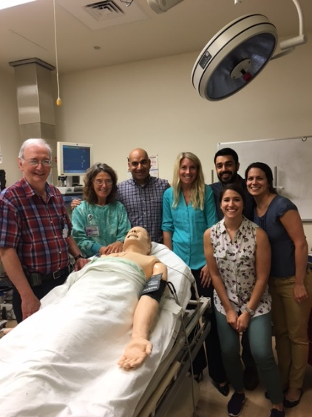
Northwestern – Upcoming Events
Residency Social Event – late March
MKSAP Day – April 4
Landsberg Research Day – April 6
Resident Diversity Showcase – April 29
Resident Research Day – May 11
Class of 2020 arrives! – June 20
Class of 2007 Reunion – July 21
Northwestern IM Residency Alumni’s Landsberg Society – First Annual Meeting – September 15-16
Other events…Advocacy, Women Prof Dev, Diversity Council, Interest Group, Research, Primary Care and Career Development…
Twitter: @NU_IntMed

Slide 56
Life Events
Engagements:
Claire Beveridge
Yuan Cao
Carlos Galvez
Kirti Johal
Michael Oh
Emily Nosova
Meredith Sellers
Saba Shaikh
Nick Simon
Stan Swat
Nick Viall
Bill Werbel
Weddings
Andrew Davis
Sara Kiely
John Reynolds
Keerthi Ranganath
Babies
Michael Burns
Greg Cascino
Kim Dow
Mary-Kate Malecek
Chi Chi Ononye
Michael Schieber

Slide 57
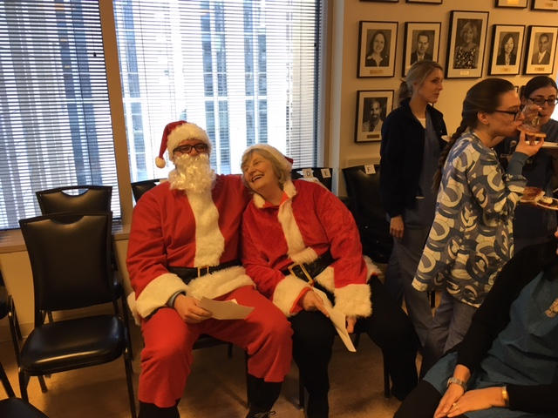
Notes:
Maija Retirement Residency Alumni Celebration

